Slide 1
Welcome to the Day 1 Session on Data Scraping
For this session, you will need:
Python3, I will be sharing a Python Notebook for everyone to work through with me.
Selenium: https://selenium-python.readthedocs.io/ I usually use pip or conda to install packages:
pip install selenium
or
conda install -c anaconda selenium
Beautiful Soup: https://www.crummy.com/software/BeautifulSoup/bs4/doc/
pip install beautifulsoup4
or
conda install -c anaconda beautifulsoup4
Gecko drivers for my web browser https://selenium-python.readthedocs.io/installation.html#drivers
You have to put the geckodriver binary in a path Python can see, if my case I have it in ~/anaconda3/bin/
Once you have done that, hopefully running the following code snippet:
from selenium import webdriver
browser = webdriver.Firefox() # Or which ever web browser you are using
browser.get("https://www.literaryclock.com/“)
you should get a popup window (sorry!) of the Literary Clock website.
The exercise notebook can be found here:
https://canvas.ox.ac.uk/courses/112935/modules/items/1537934

Slide 2

Welcome to the BDI Python Code Clinic on Data Scraping

Slide 3
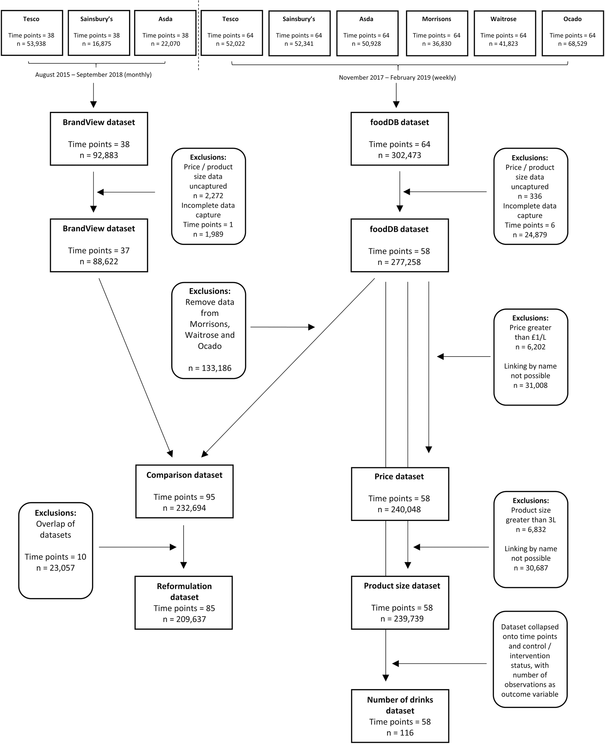

Slide 4

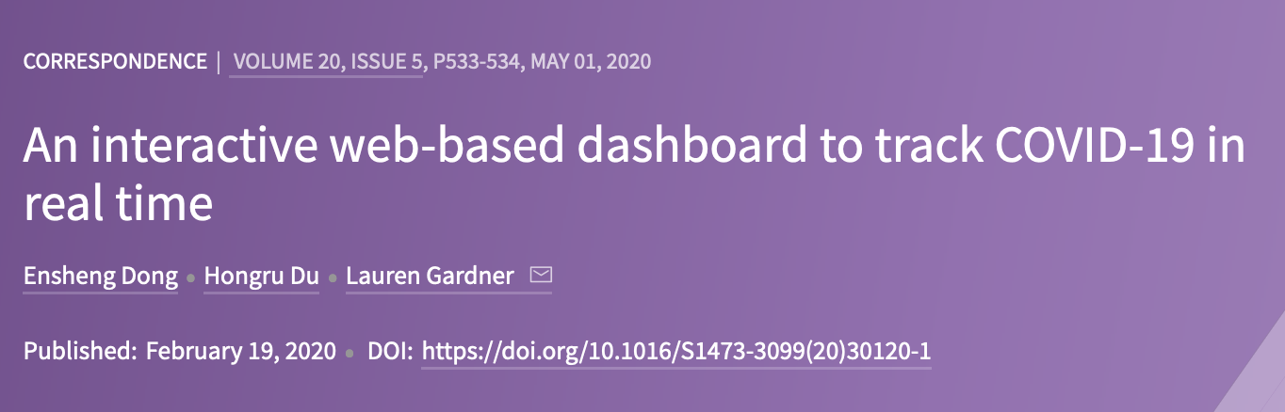

Slide 5
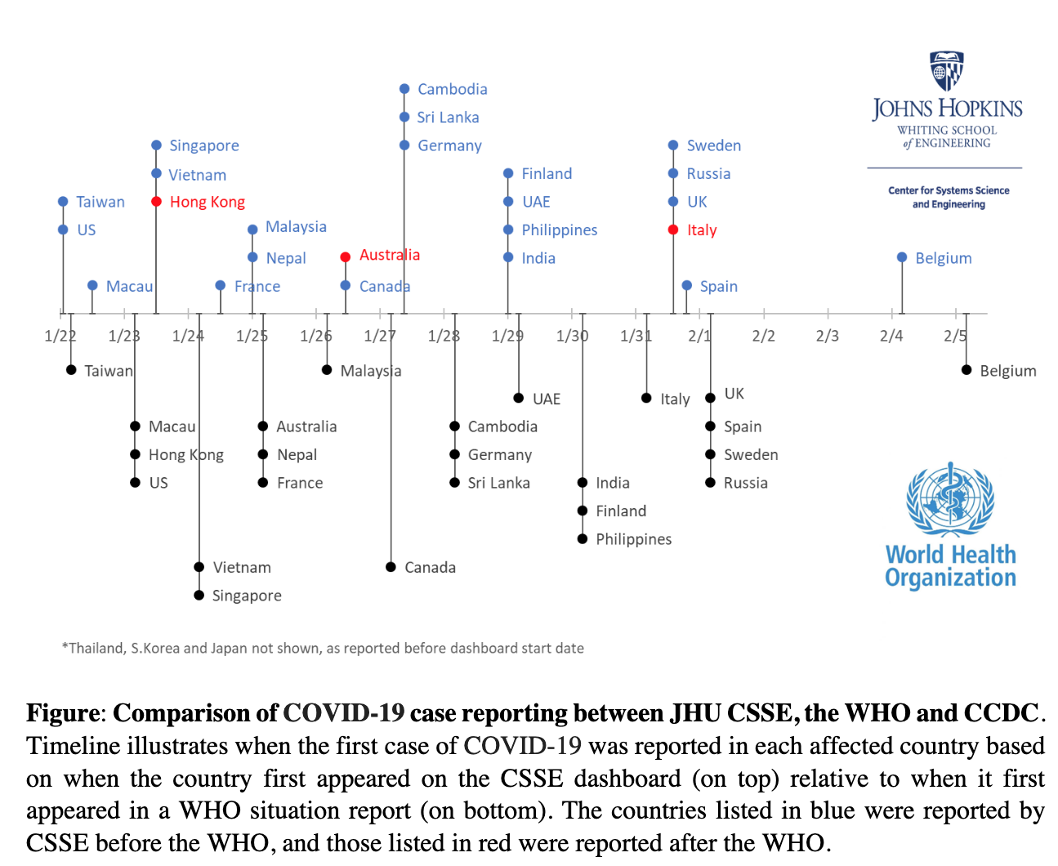

Slide 6
